Slide 1


Sponsored Programs Administration Resource & Knowledge Series
AWARD MANAGEMENT
PART II
Presented by:
Cookie Kaur, Greg Robinson, Terri Vallery

Slide 2
General Business
TEAM PROJECTS
Due date – August 24th
Contact your mentor if you have questions or need guidance
Nancy Nisbett: Justo Torres:
407.882.2233 407.882.1131
Nancy.Nisbett@ucf.edu Justo.Torres@ucf.edu
Svetlana Shtrom: Laurianne Torres:
407.823.5150 407.882.0113
Svetlana.Shtrom@ucf.edu Laurianne.Torres@ucf.edu
AWARD MANAGEMENT – PART II

Slide 3
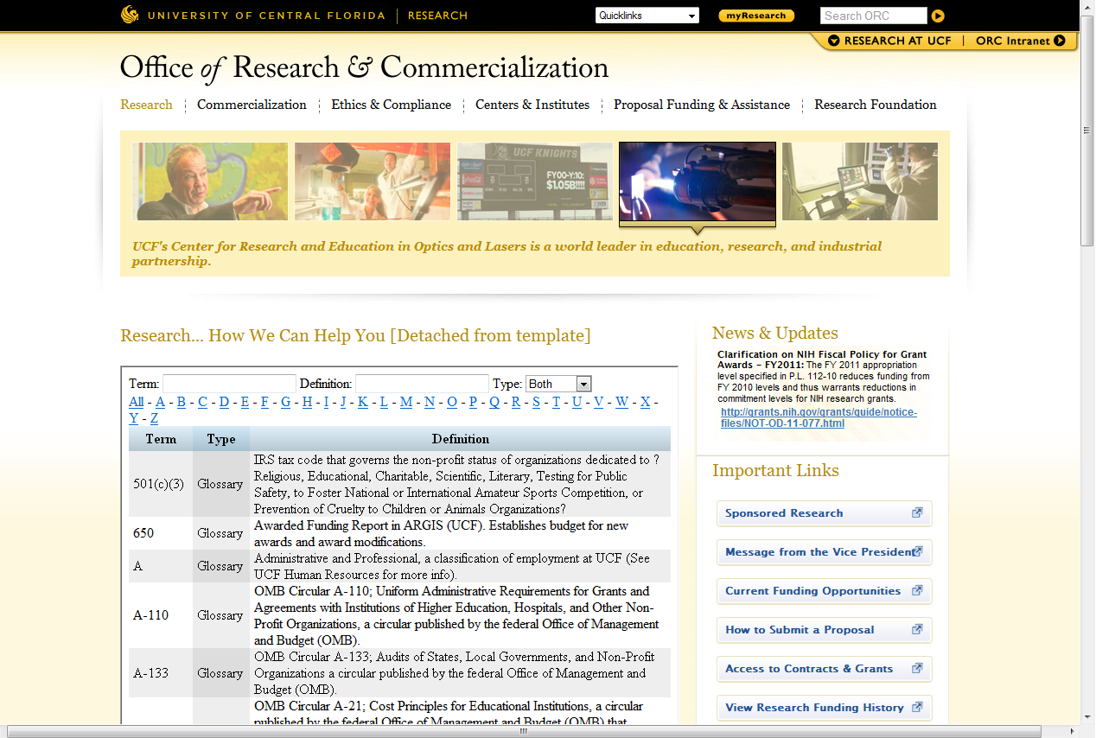
General Business
Glossary of Research Terms now live!
http://www.research.ucf.edu/research.glossary.html
AWARD MANAGEMENT – PART II

Slide 4
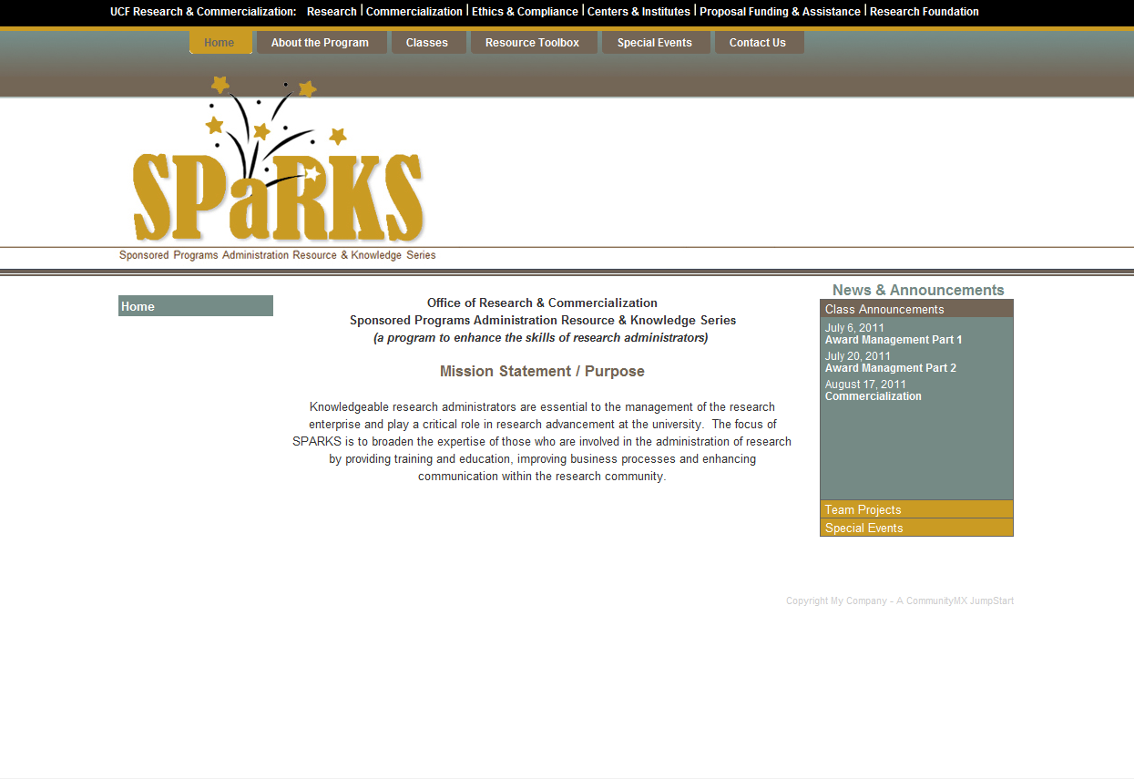
General Business
SPaRKS website now live!
www.sparks.research.ucf.edu
AWARD MANAGEMENT – PART II

Slide 5
General Business
+
=
Please hold questions until the end of each section
AWARD MANAGEMENT – PART II

Slide 6
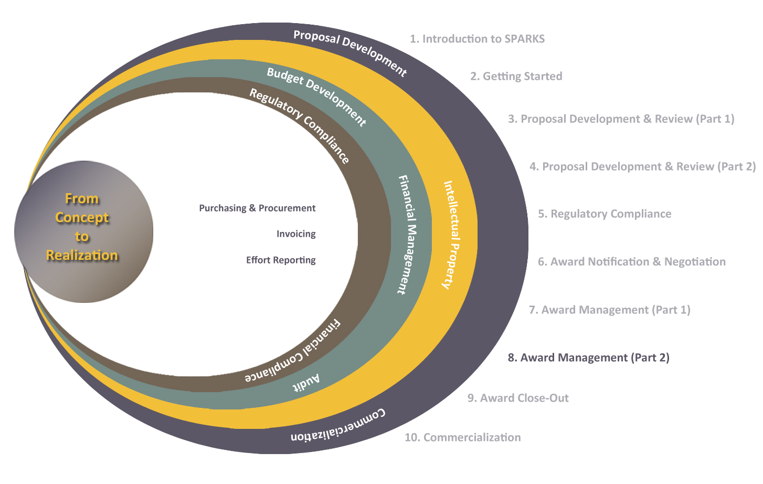
Exploring Research Administration from Concept to Commercialization

Slide 7
Exploring Research Administration from Concept to Commercialization
FINANCIAL ADMINISTRATION
Anatomy of an Account Number
Cash Management
Invoicing
Program Income
Terri Vallery

Slide 8
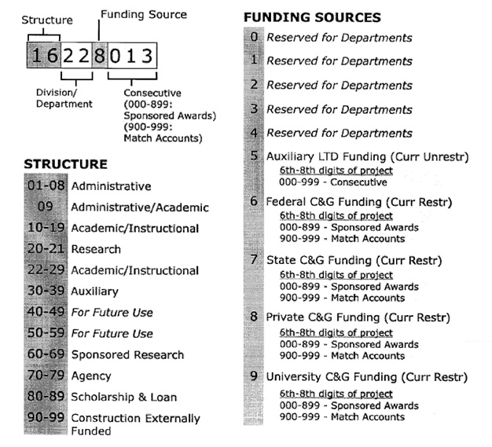
ANATOMY OF AN ACCOUNT NUMBER
AWARD MANAGEMENT – PART II

Slide 9


CASH MANAGEMENT
Accounts are established with a promise of funding,
not cash in hand
AWARD MANAGEMENT – PART II

Slide 10

CASH MANAGEMENT
Funds are received by the university for sponsored projects via:
Draw down
Invoicing
Advanced payments
Appropriations
When funds aren’t received as promised, the university must cover the deficit by account write-off

Slide 11

CASH MANAGEMENT
Cash Management Concerns
Rate of Spending
Too fast or too slow
Spending down
Caution with fixed price
Timing of Expenditures
Too close to end date
Do the costs follow the Cost Accounting Standards?
AWARD MANAGEMENT – PART II

Slide 12

INVOICING
Things to Consider:
Differing types of agreements
Date of invoice submission
Hourly rates
Frequency
Schedule
Connected to deliverables
Format consistent with type of agreement
AWARD MANAGEMENT – PART II

Slide 13

PROGRAM INCOME
Defined in OMB Circular A-100 and incorporated in 45 CFR, Part 74
Revenue resulting from sponsored project activities that is earned from a third party during the project period.
Examples include but are not limited to:
1. Fees for services performed, such as lab tests
2. Sale of software, tapes or publications
3. Sale of research materials, such as animal models or reagents
4. Fees from participants at conferences or symposia
5. Revenue from the use, sale or rental of equipment purchased with project funds
AWARD MANAGEMENT – PART II

Slide 14
PROGRAM INCOME
Obligations to Federal Government do not extend to:
Program income after the end of the project period
License fees & Royalties for copyrighted material
Patents
Patent applications
Trademarks
Inventions
Patient care credits
Interest earned on advances of federal funds
Purchasing credits or discounts

Slide 15
PROGRAM INCOME
Example: A sponsor awards $100,000 for a project. The project generates an income of $30,000.
Circular A-110 dictates which way Program Income is used:
Additive
Cost/Share Match
Deductive
Additive/Deductive

Slide 16
PROGRAM INCOME
ADDITIVE:
Program income is added to the funds committed to the project by the Federal awarding agency and recipient and used to further eligible project or program objectives.
Example: The total project cost could now be $130,000. The additional funds should be kept in a separate sponsored project account and would need to be reported to the sponsor.

Slide 17
PROGRAM INCOME
COST SHARE/MATCH:
Program income is used to finance the non-Federal share of the project.
Example: If the University was required to match project funds in the amount of $50,000, the University would now only have to provide an additional $20,000, using the $30,000 in program income as part of the match. The sponsor would still pay $100,000.

Slide 18
PROGRAM INCOME
DEDUCTIVE:
Program income is deducted from the total project or program allowable cost in determining the net allowable costs on which the Federal share of cost is based.
Example: The sponsor deducts $30,000 of program income from the original award of $100,000, and will now only fund $70,000 of the total project costs.

Slide 19
PROGRAM INCOME
ADDITIVE/DEDUCTIVE:
When a sponsor limits either additive or cost share/match program income, any program income in excess of the limits shall be used in accordance with the deductive method.
Example: If the sponsor limit is $25,000, then $25,000 can be added to the total project cost and $5,000 will be deducted from the total award to reduce the award to $95,000. The total amount available is $120,000.

Slide 20
Exploring Research Administration from Concept to Commercialization
PURCHASING & PROCUREMENT
Mission Statement & Authority
Procurement Guidelines
Exemptions
Purchasing Cycle
Greg Robinson

Slide 21
MISSION STATEMENT & AUTHORITY
Mission Statement
To support the academic and administrative departments in the procurement of goods and services, which sustain, foster, and promote the teaching, research, and service mission of the University.
Authority (6C7-7.130, F.A.C. and 1001.74, F.S.)
Develop purchasing procedures.
Canvas sources of supply and contracting for the purchase or lease of all commodities and contractual services for the University.
Recommend or advise the suspension or debarment of a contractor.
Plan and coordinate purchases in volume.
Develop an Annual Certification List to serve as a waiver of the competitive solicitation.
AWARD MANAGEMENT – PART II

Slide 22
PROCUREMENT GUIDELINES
Purchasing involves the acquisition of:
Equipment
Supplies
Facility Improvement
Preventative Maintenance
Contractual Services
Leases of Space
Purchasing plays a role in:
Planning and preparation of specifications for bids
Solicitations
Award and administration of formal bids
Submitting informal requests for quotes
Diversity in contracts
AWARD MANAGEMENT – PART II

Slide 23
EXEMPTIONS
Sole Source
Commodities and contractual services purchased for any amount exceeding $50,000, available only from a single source, may be exempted from the bid requirements when the University certifies and documents that there is only one source of supply capable of meeting the University’s requirements. A purchase order may be issued for the noncompetitive item(s) when the Sole Source Certification is approved by the General Counsel and appropriate Vice President/Dean, and after posting it for 72 hours in a public place in the Purchasing Office.
AWARD MANAGEMENT – PART II

Slide 24
EXEMPTIONS
Sponsored Research Exemption
All purchases of a division of sponsored research shall be made in accordance with the policies and procedures of the university; however, upon certification addressed to the university president that it is necessary for the efficient or expeditious prosecution of a research project, the president may exempt the purchase of material, supplies, equipment, or services for research purposes from the general purchasing requirement of the Florida Statutes.
AWARD MANAGEMENT – PART II

Slide 25
EXEMPTIONS
State Contract
The University may acquire any commodity which is available on any contract or price agreement executed by the State Division of Purchasing when such purchase is most advantageous to the University, with price, quality, performance and other factors considered. All state contract purchases by the University are exempt from competitive bid requirements.
AWARD MANAGEMENT – PART II

Slide 26
PURCHASING CYCLE
2 Calendar days if non-bid/quote requirement
3 Calendar days if only oral quotations are required
5 Calendar days if informal written quotation(s) is/are required
30+ Calendar days if formal bids are required
60+ Calendar days if formal Request for Proposal is required
15-20 Additional days if external level approval(s) is/are needed for any of the above.
AWARD MANAGEMENT – PART II

Slide 27

THINK ABOUT IT…
Which of the following are funds that have been set aside for projected expenses pending actual expenditure of the funds?
a. Encumbrance Funds.
b. Direct Funds.
c. Indirect Funds.
d. None of the Above.
AWARD MANAGEMENT – PART II

Slide 28
Exploring Research Administration from Concept to Commercialization
COMPLIANCE CONSIDERATIONS
Effort Reporting
Cookie Kaur

Slide 29
EFFORT REPORTING
ef·fort (n.) - the proportion of time spent on any activity and expressed as a percentage of the total professional activity for which an individual is employed by the institution
Effort Reporting is the only means that the Federal Government
has to verify that salary dollars were charged properly,
either as a direct-charge or cost-share.
AWARD MANAGEMENT – PART II

Slide 30
EFFORT REPORTING
Employees must account for
all activities in their assignment
For Faculty, this usually means:
Teaching
Research
Service
AWARD MANAGEMENT – PART II

Slide 31
EFFORT REPORTING
Who has to certify effort?
Any individual (Faculty, A&P, USPS, OPS) who works any portion
of their time on sponsored projects or activities whether
compensated or uncompensated by that project is required to
certify effort.
AWARD MANAGEMENT – PART II

Slide 32
EFFORT REPORTING
When should one certify?
According to A-21, at least twice per year
At UCF, it is 3 times per year (at the end of each semester)
AWARD MANAGEMENT – PART II

Slide 33
EFFORT REPORTING
Important Things to Consider
Effort reporting is a reasonable estimate, not an exact science.
Degree of Tolerance: Certification must rely on a reasonable estimate of effort during a specified time period, and when estimating, a degree of tolerance is acceptable and appropriate. UCF recognizes this degree of tolerance to be no more than +/- 5%.
Payroll Transfers: Anytime that payroll does not accurately reflect how the employee spent his/her time on the certified effort report by a margin of +/- 5%, a payroll transfer request is necessary.
AWARD MANAGEMENT – PART II

Slide 34
EFFORT REPORTING
Important Things to Consider
Effort is not based on a 40 hour work week.
Total effort must equal 100%.
The total effort expended cannot be more than (or less than) 100%, whether the employee certifying effort is full time or part time.
In other words, an employee who is a .5 FTE certifies 100% of their .5 FTE
AWARD MANAGEMENT – PART II

Slide 35
EFFORT REPORTING
Important Things to Consider
Effort Certification must be performed by the individual, not his/her designee
First-Hand Knowledge: Either the individual or someone having firsthand knowledge of the activities performed by employee
Suitable Means of Verification: The person certifying must have "suitable means of verification that the work was performed."
Employee’s Absence: In the employee’s absence, the PI for a specific project may certify the effort of the employees working on the PI’s project.
Laboratory Personnel: Lab personnel may be conducting experimentation but be unaware of which specific projects they are working towards, in these cases, the PI may certify their effort.
Departmental Staff: Certification of effort by a departmental secretary or other staff is not permitted.
AWARD MANAGEMENT – PART II

Slide 36


EFFORT REPORTING
Employee reviews the report for accuracy
Salary Costs charged based on work performed
End of Semester rolls around
Reports are generated and sent out
Employee “agrees” or “disagrees”
if Employee “disagrees,” adjustments are made and a new report is sent (and employee agrees)
AWARD MANAGEMENT – PART II

Slide 37
THINK ABOUT IT…
All of the following are true about effort reporting except:
a. Effort must be certified no less frequently than every six months.
b. OMB Circular A-21 permits three different effort reporting methods.
c. Effort can be expressed in terms of hours or a percentage of total effort.
d. Is required of anyone working on a sponsored project, whether compensated or not.
AWARD MANAGEMENT – PART II

Slide 38

QUESTIONS or COMMENTS?

Slide 39
THANKS FOR JOINING US!
Please come to the next session:
AWARD CLOSE-OUT
August 3, 2011
10:00 am to 12:00 pm
Sponsored Programs Administration Resource & Knowledge Series

